Slide 1
Introduction to Artificial Neural networks
Chapter 1

Slide 2
Contents
From biological to artificial neurons
The perceptron
Multilayer perceptron
Activation Functions
Feed forward neural networks
Back propagation algorithm
Fine tuning neural network hyperparameters
Number of hidden layers
Number of neurons per hidden layer
Learning rate
Batch size and other hyperparameters

Slide 3
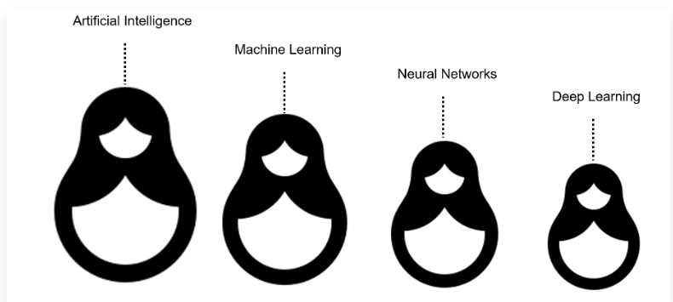
Introduction-AI, Machine Learning and Deep Learning
That is, machine learning is a subfield of artificial intelligence. Deep learning is a subfield of machine learning, and neural networks make up the backbone of deep learning algorithms

Slide 4
Machine Learning
Machine Learning is a subset of artificial intelligence focusing on a specific goal: setting computers up to be able to perform tasks without the need for explicit programming.
Computers are fed structured data (in most cases) and ‘learn’ to become better at evaluating and acting on that data over time.
Machine learning is about computers being able to perform tasks without being explicitly programmed… but the computers still think and act like machines. Their ability to perform some complex tasks — gathering data from an image or video, for example — still falls far short of what humans are capable of.
Hence there is a need to build “Intelligent Machine”

Slide 5
Problems with Traditional Programming
Traditional computer programs are designed to be very good at two things
Performing arithmetic really fast
Explicitly following a list of instructions
Problems:
We cannot write the list of instructions to recognize a face or to write a instruction to automatically recognize someone’s handwriting

Slide 6
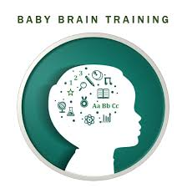
Building an Intelligent Machine
Consider the example of an “infant brain”, It weighs a single pound, but somehow it solves problems that even our biggest, most powerful supercomputers find impossible
Within a matter of months after birth, infants can recognize the faces of their parents, discern discrete objects from their backgrounds, and even tell apart voices
Within a year, they’ve already developed an intuition for natural physics, can track objects even when they become partially or completely blocked, and can associate sounds with specific meanings.
And by early childhood, they have a sophisticated understanding of grammar and thousands of words in their vocabularies
For decades, we’ve dreamed of building intelligent machines with brains like ours— robotic assistants to clean our homes, cars that drive themselves, microscopes that automatically detect diseases
But building these artificially intelligent machines requires us to solve some of the most complex computational problems we have ever grappled with; problems that our brains can already solve in a manner of micro seconds.

Slide 7
How exactly Identification of objects can be done?
For instance, when we were two years old, our parents didn’t teach us how to recognize a dog by measuring the shape of its nose or the contours of its body.
We learned to recognize a dog by being shown multiple examples and being corrected when we made the wrong guess.
In other words, when we were born, our brains provided us with a model that described how we would be able to see the world.
As we grew up, that model would take in our sensory inputs and make a guess about what we were experiencing.
If that guess was confirmed by our parents, our model would be rein‐ forced. If our parents said we were wrong, we’d modify our model to incorporate this new information.
Over our lifetime, our model becomes more and more accurate as we assimilate more and more examples

Slide 8
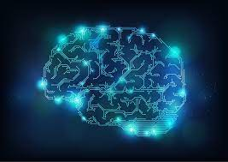
What is Deep Learning?
Deep learning is a subset of a more general field of artificial intelligence called machine learning, which is predicated on this idea of learning from example.
In machine learning, instead of teaching a computer a massive list of rules to solve the problem, we give it a model with which it can evaluate examples, and a small set of instructions to modify the model when it makes a mistake.
We expect that, over time, a well-suited model would be able to solve the problem extremely accurately.

Slide 9
The neuron-Human Brain (Analogy for Deep learning)
The foundational unit of the human brain is the neuron.
At its core, the neuron is optimized to receive information from other neurons, process this information in a unique way, and send its result to other cells.
The neuron receives its inputs along antennae like structures called dendrites.
Each of these incoming connections is dynamically strengthened or weakened based on how often it is used.
After being weighted by the strength of their respective connections, the inputs are summed together in the cell body.
This sum is then transformed into a new signal that’s propagated along the cell’s axon and sent off to other neurons.

Slide 10
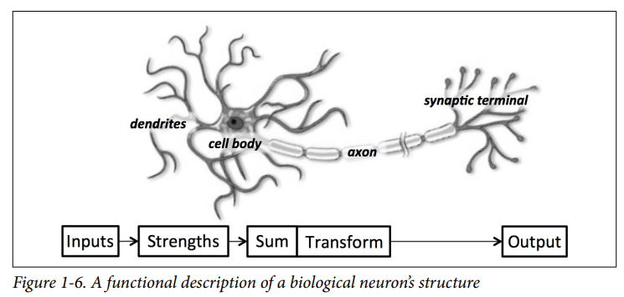

Slide 11
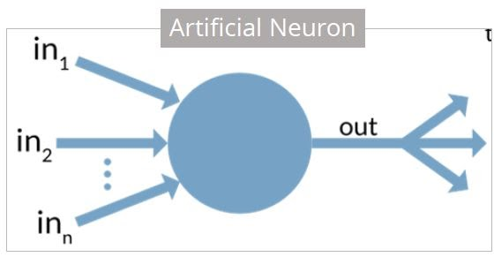
Artificial Neuron
An artificial neuron is a mathematical function based on a model of biological neurons, where each neuron takes inputs, weighs them separately, sums them up and passes this sum through a nonlinear function to produce output.

Slide 12
Characteristics of artificial neurons
A neuron is a mathematical function modeled on the working of biological neurons
It is an elementary unit in an artificial neural network
One or more inputs are separately weighted
Inputs are summed and passed through a nonlinear function to produce output
Every neuron holds an internal state called activation signal

Slide 13
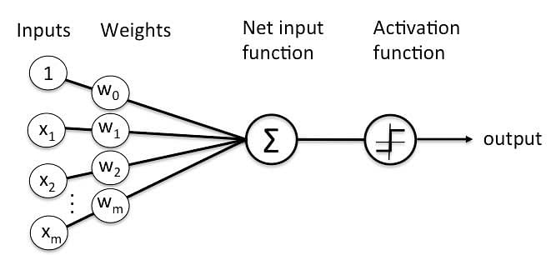
What is Perceptron?
Perceptron is a building block of an artificial neural network. It is also understood as an Artificial neuron or neural network unit that helps to detect certain data computations in business intelligence.

Slide 14
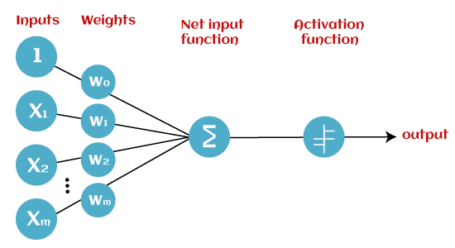
Basic Components of Perceptron

Slide 15
Input Nodes or Input Layer: This is the primary component of Perceptron which accepts the initial data into the system for further processing.
Weight and Bias: Weight parameter represents the strength of the connection between units. This is another most important parameter of Perceptron components. Weight is directly proportional to the strength of the associated input neuron in deciding the output. Bias can be considered as the line of intercept in a linear equation.
Activation Function : These are the final and important components that help to determine whether the neuron will fire or not. Activation Function can be considered primarily as a step function.

Slide 16
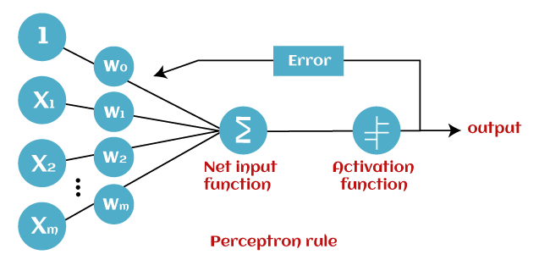
Working of Perceptron
Perceptron is considered as a single-layer neural network that consists of four main parameters named input values (Input nodes), weights and Bias, net sum, and an activation function.
The perceptron model begins with the multiplication of all input values and their weights, then adds these values together to create the weighted sum.
Then this weighted sum is applied to the activation function 'f' to obtain the desired output.
This activation function is also known as the step function and is represented by 'f'.

Slide 17
This step function or Activation function plays a vital role in ensuring that output is mapped between required values (0,1) or (-1,1).
It is important to note that the weight of input is indicative of the strength of a node. Similarly, an input's bias value gives the ability to shift the activation function curve up or down.
Step 1: In the first step first, multiply all input values with corresponding weight values and then add them to determine the weighted sum.
∑wi*xi = x1*w1 + x2*w2 +…wn*xn
Add a special term called bias 'b' to this weighted sum to improve the model's performance.
∑wi*xi + b
Step 2: In the second step, an activation function is applied with the above-mentioned weighted sum, which gives us output either in binary form or a continuous value as follows:
Y = f(∑wi*xi + b)

Slide 18
Types of Perceptron Models
Based on the layers, Perceptron models are divided into two types. These are as follows:
1. Single-layer Perceptron Model : A single-layered perceptron model consists feed-forward network and also includes a threshold transfer function inside the model.
The main objective of the single-layer perceptron model is to analyze the linearly separable objects with binary outcomes.
In a single layer perceptron model, its algorithms do not contain recorded data, so it begins with inconstantly allocated input for weight parameters.
Further, it sums up all inputs (weight). After adding all inputs, if the total sum of all inputs is more than a pre-determined value, the model gets activated and shows the output value as +1.
If the outcome is same as pre-determined or threshold value, then the performance of this model is stated as satisfied, and weight demand does not change.
"Single-layer perceptron can learn only linearly separable patterns."

Slide 19
Multi-Layered Perceptron Model
Like a single-layer perceptron model, a multi-layer perceptron model also has the same model structure but has a greater number of hidden layers.
The multi-layer perceptron model is also known as the Backpropagation algorithm, which executes in two stages as follows:
Forward Stage: Activation functions start from the input layer in the forward stage and terminate on the output layer.
Backward Stage: In the backward stage, weight and bias values are modified as per the model's requirement. In this stage, the error between actual output and demanded originated backward on the output layer and ended on the input layer.

